Slide 1
Analytics using Clickstream Data
Visualizations and Insights using R
By:
Anish Anand

Slide 2
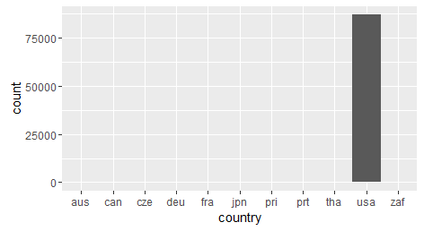
Analytics using Clickstream Data
Visualizations
Hereby, I have included visualizations done on both R and Excel 2013(powerview). The code of visualizations in R are however shared in the code at the end.
Expected Outcomes
Analyze the clickstream data by location
The adjacent visualization shows that most of the clicks have been done from the United States of America(usa) and then Puerto Rico(pri).
Hence, this shall form the basis of our analysis and all the further visualizations has been done for the people and clicks obtained from usa.

Slide 3
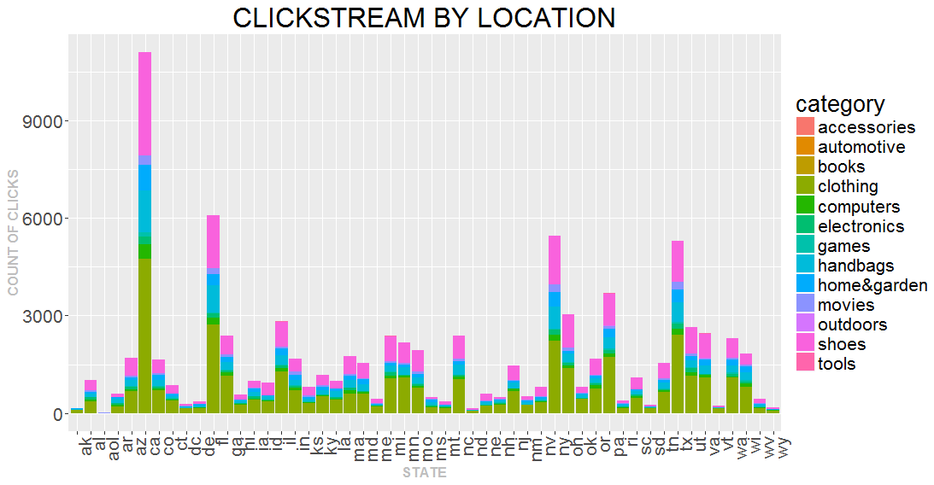
Analytics using Clickstream Data
Moreover, we can see that the product category of clothing sites were most visited by people across the United States. Moreover, one more insight is that the people of Columbia (CA) and New York (NY) are actively present online, searching for products to buy. Apart from that, the crowd of Arizona shows significant interest in electronics products too.
Target geographical area as per customer interest can be another insight from the visualization.
Moreover, one more insight is
that the people of Columbia(CA),
Florida (fl) and New York(NY) are
actively present online searching
for products to buy.

Slide 4
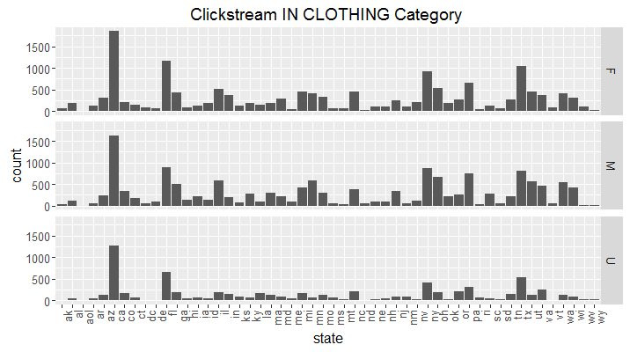
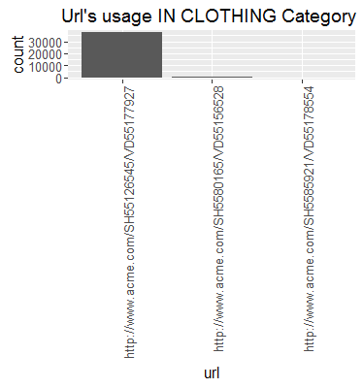
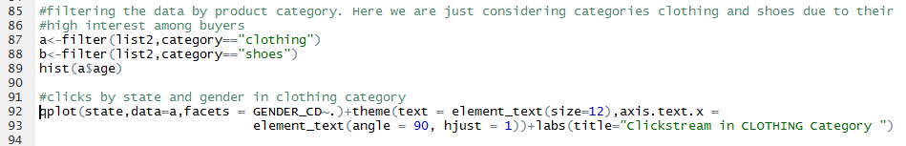
Analytics using Clickstream Data
Filter the data by product category

Slide 5
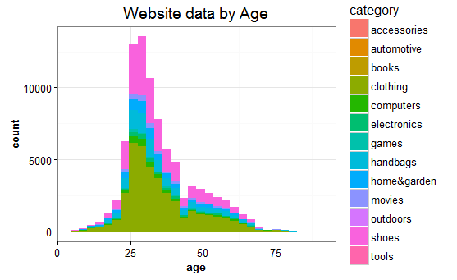
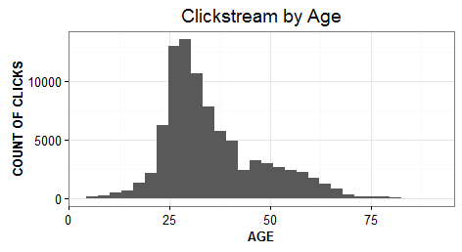
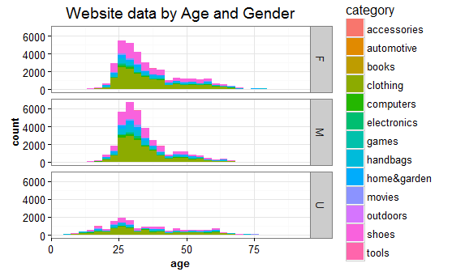
Analytics using Clickstream Data
Graph the website user data by age and gender
The adjacent plots are basically stacked bar plots. From the visualizations we can see that
Clothing sites remain all time favorite destination for both males and females shoppers.
Moreover, the handbags, home&garden and shoes websites bag the 2nd favorite place among the buyers.
Subtle traces of interests for electronics can also be seen among the buyers
Most shoppers are seen from 24-33 years of age(approx.)

Slide 6
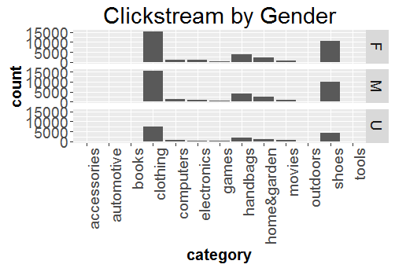
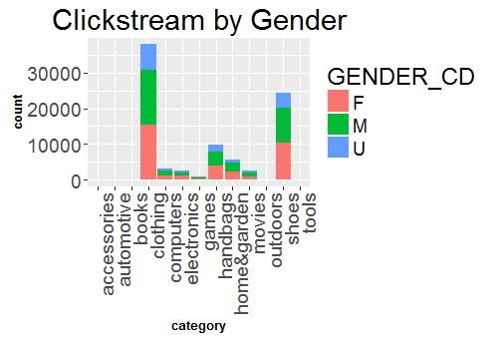
Analytics using Clickstream Data
Basically 3 gender fields are covered, namely
Male(M)
Female(F)
Custom gender(U).
The males and females however continue to mark clothing sites as their favorite shopping destination.
Moreover, most buyers of shoes are females, and the males tend to be in majority when it comes to computers and games. This perhaps is due to the psychological traits of these genders. Some websites corresponding to automotive, tools and accessories are not much in trend among the internet shoppers of usa

Slide 7
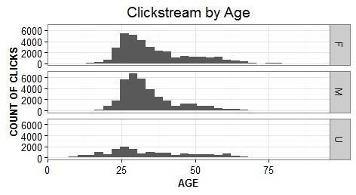
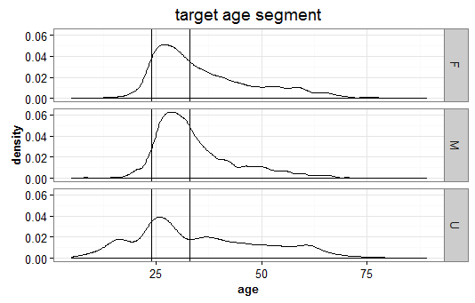
Analytics using Clickstream Data
Pick a target customer segment
All in all, we can say that age segment of 24-33 years can be targeted by the sellers as these people can be actively seen surfing net for buying different product categories. The trend is almost same for males, females and custom categories (as can be seen from the density plot).
In above plot, we can also see that most men in the targeted age segment are interested as buyers on sites.

Slide 8
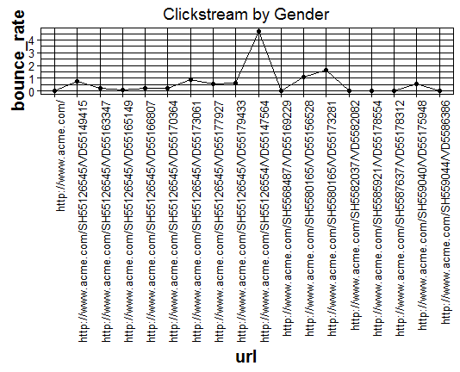
Analytics using Clickstream Data
Identify a few web pages with the highest bounce rates
Bounce rate (sometimes confused with exit rate) is an Internet marketing term used in web traffic analysis. It represents the percentage of visitors who enter the site and then leave ("bounce") rather than continuing on to view other pages within the samesite.The url having maximum bounce rates corresponds to the site which least interests the customers and proper changes are required on the site so as to lure in customers or buyers. In our scenario the url
http://www.acme.com/SH55126554/VD55147564
has the highest bounce rate which corresponds to the category of outdoor related sites.

